Slide 1
CSE 351 Design Patterns Term Project Presentation
Tevfik Kesici & Hakan Zavrak

Slide 2
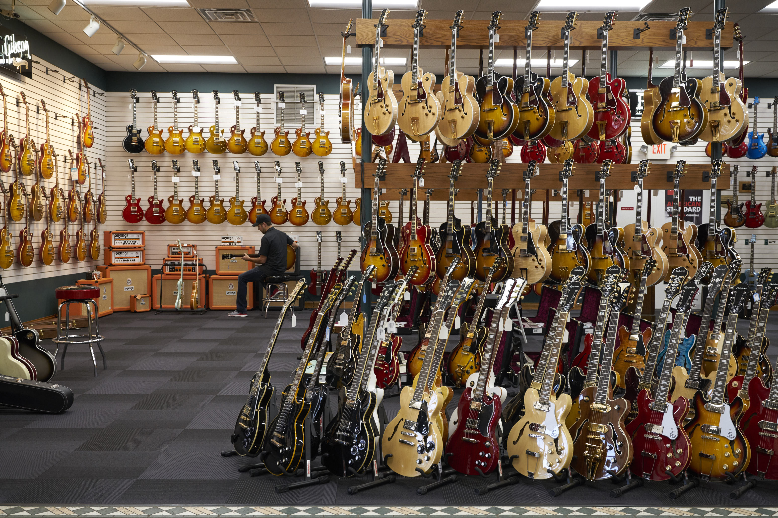

With AI
Guitar Store

Slide 3

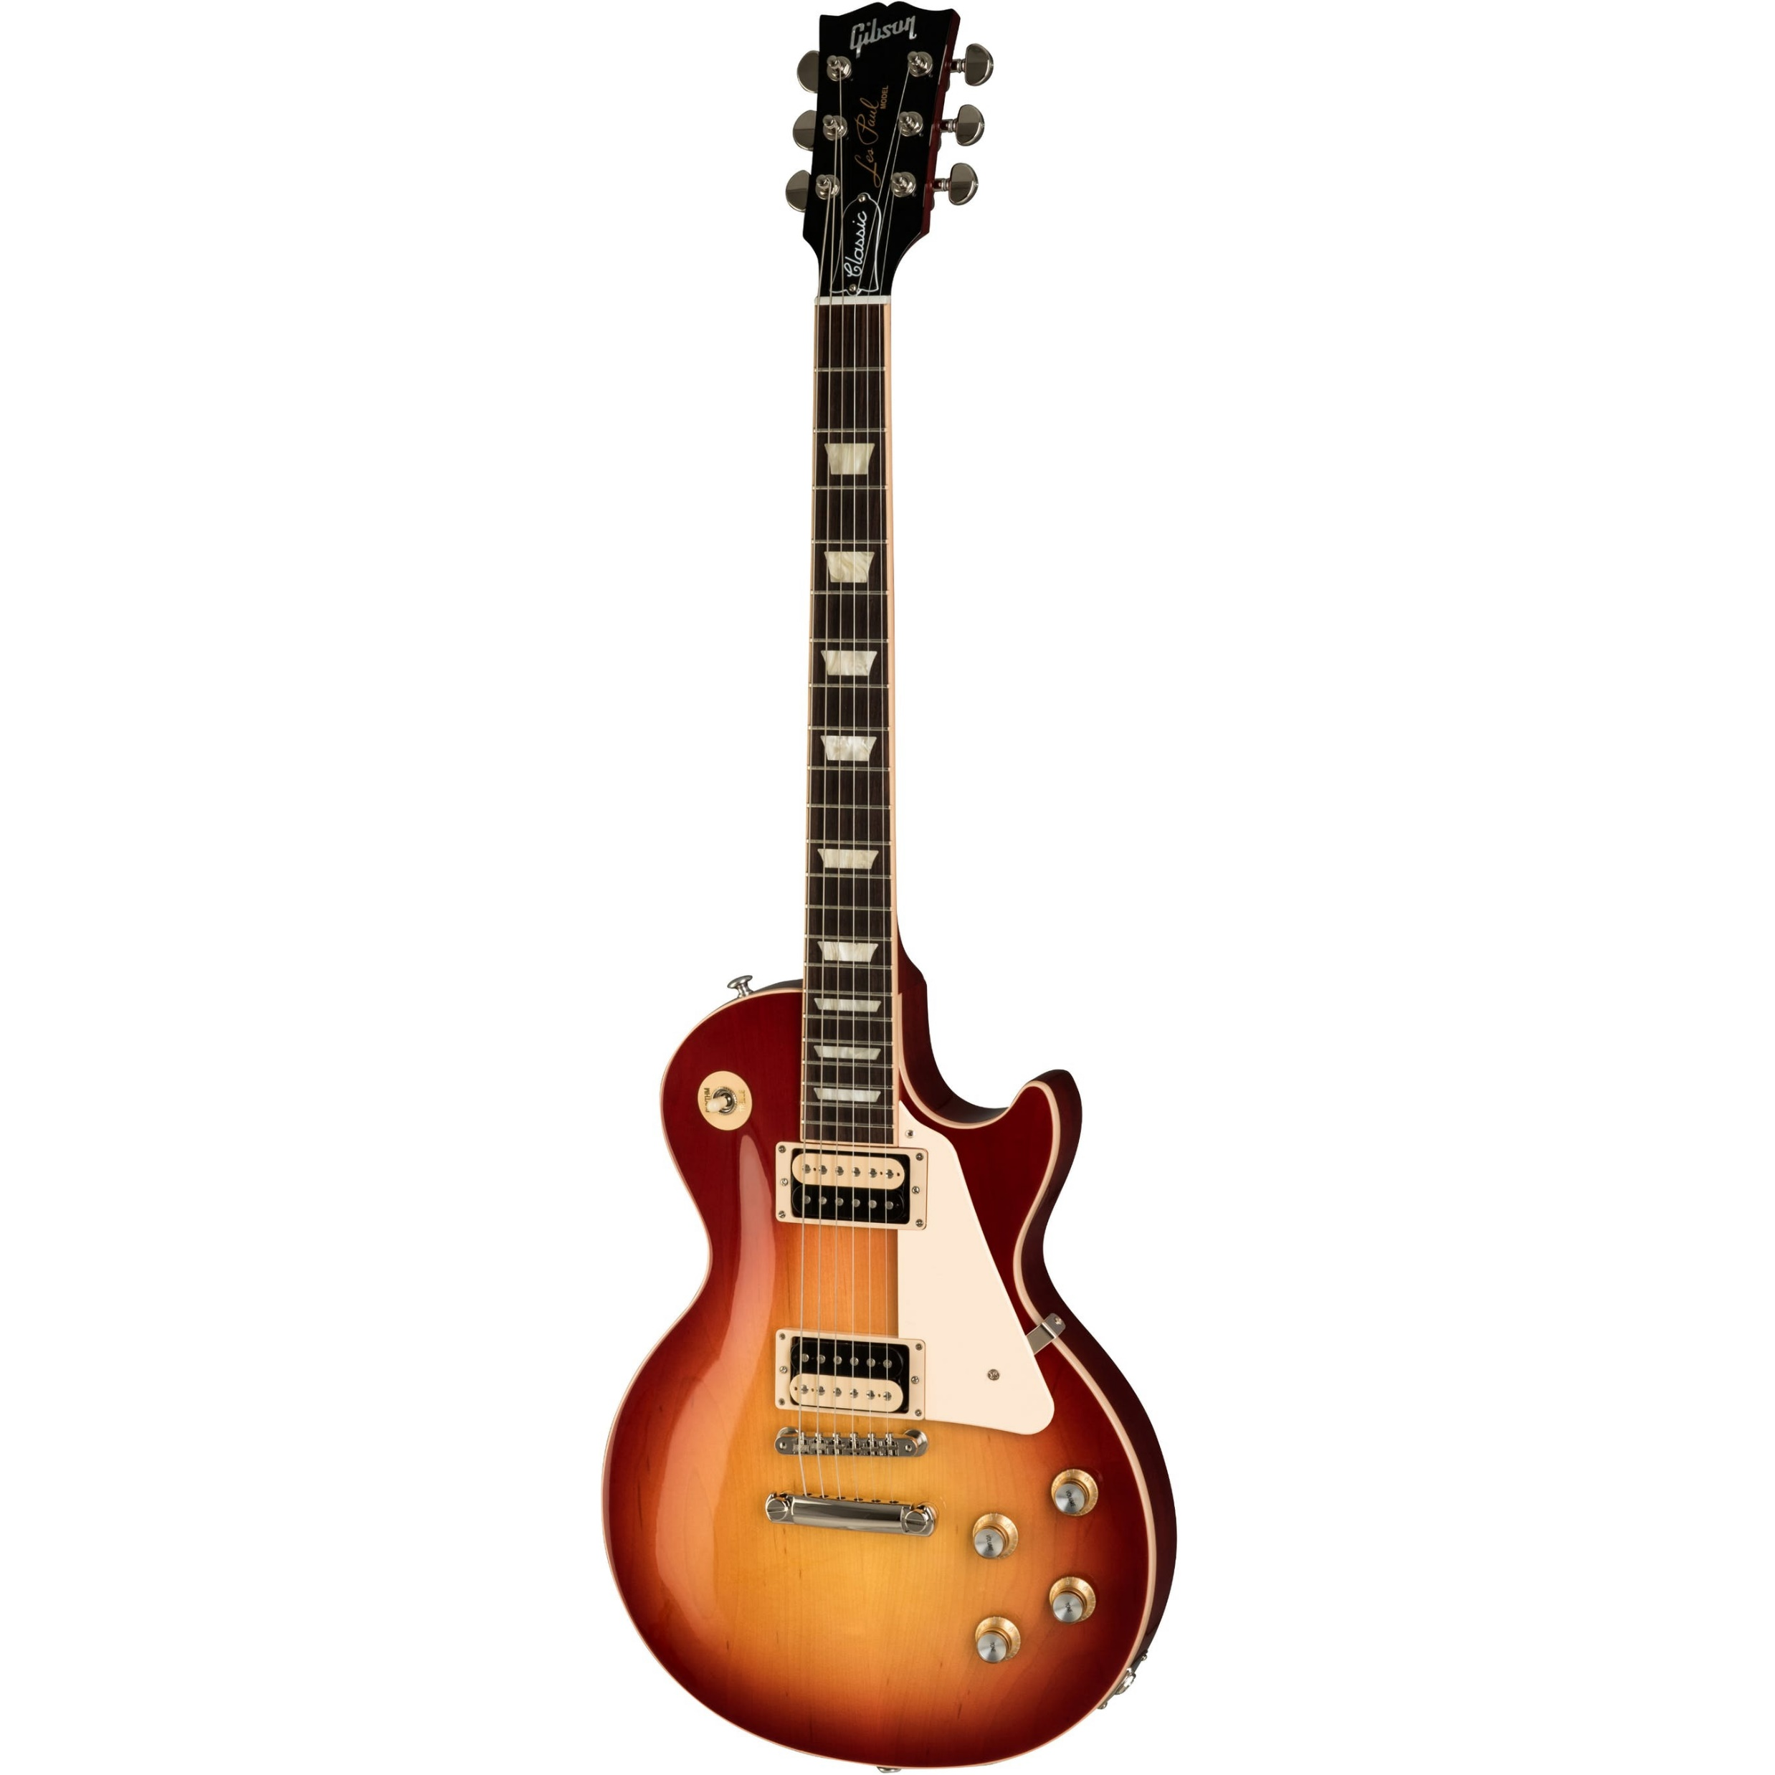
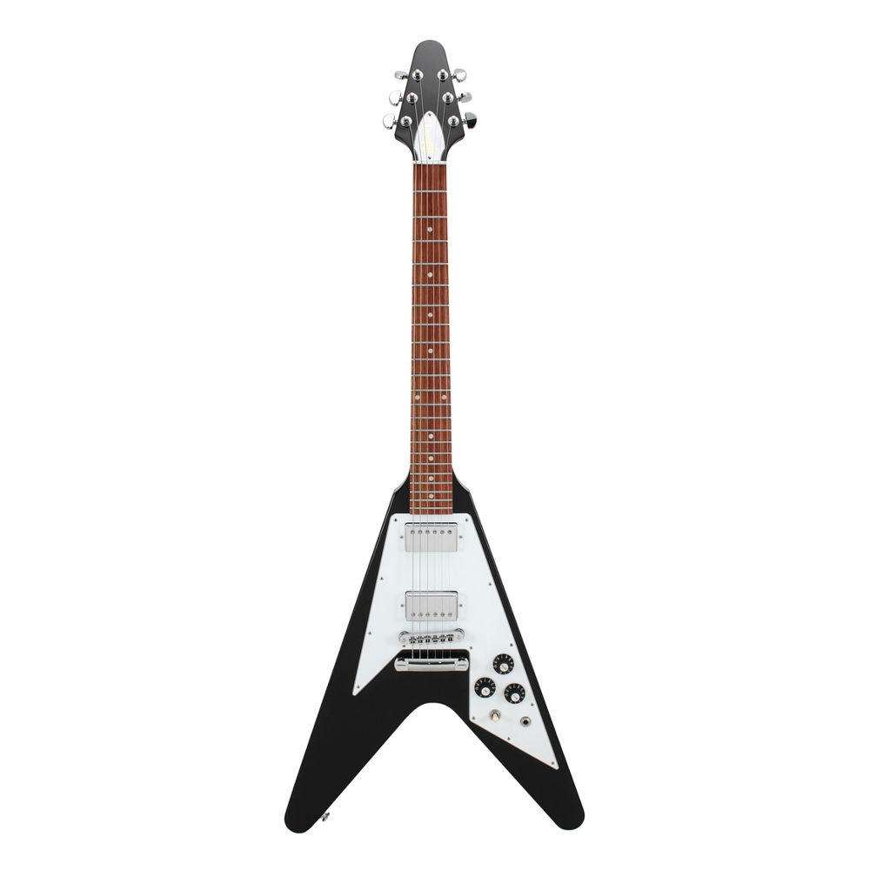
Project Definition
We are going to oparate a guitar store.
Istanbul Store
İzmir Store
Old-school models of the same manufacturer
Trending models of the same manufacturer

Slide 4
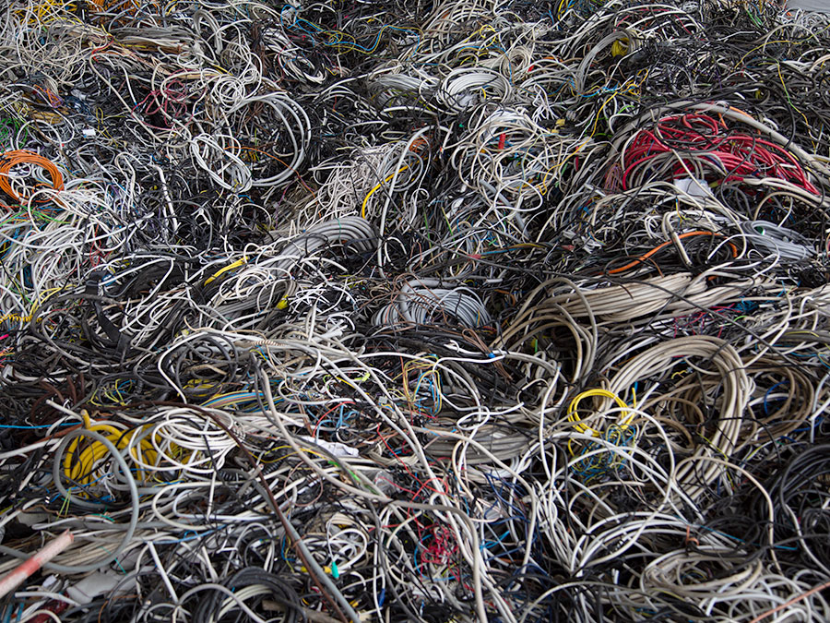
Problems
Tight Coupling

Slide 5
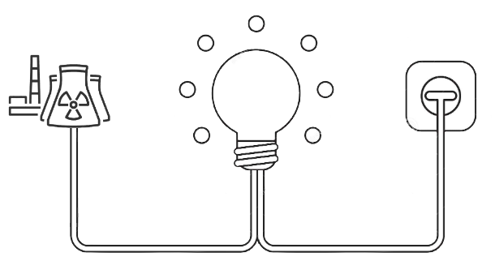
‘’You don’t have to learn how to wire things up if you need to turn on the lights. You use a socket for that.’’

Slide 6
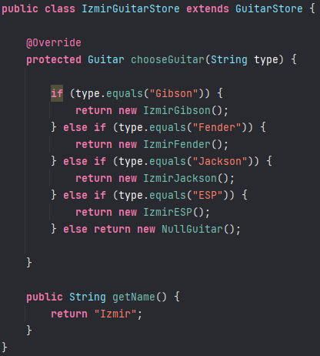
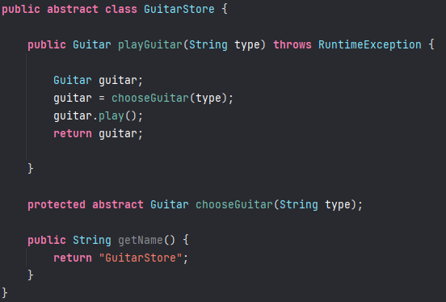
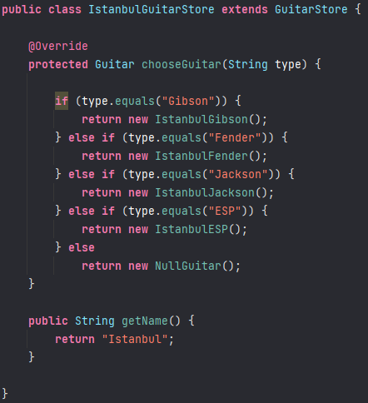
Solution

Slide 7
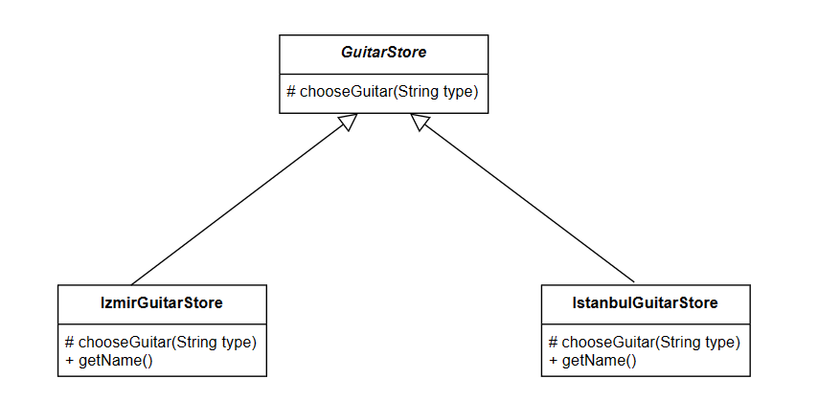

Slide 8
Conclusion
Factory method pattern was the key - Object creation is delegated to subclasses - Subclasses implement the factory method to create objects - Handles complicated construction process without impacting the other existing functionality

Slide 9
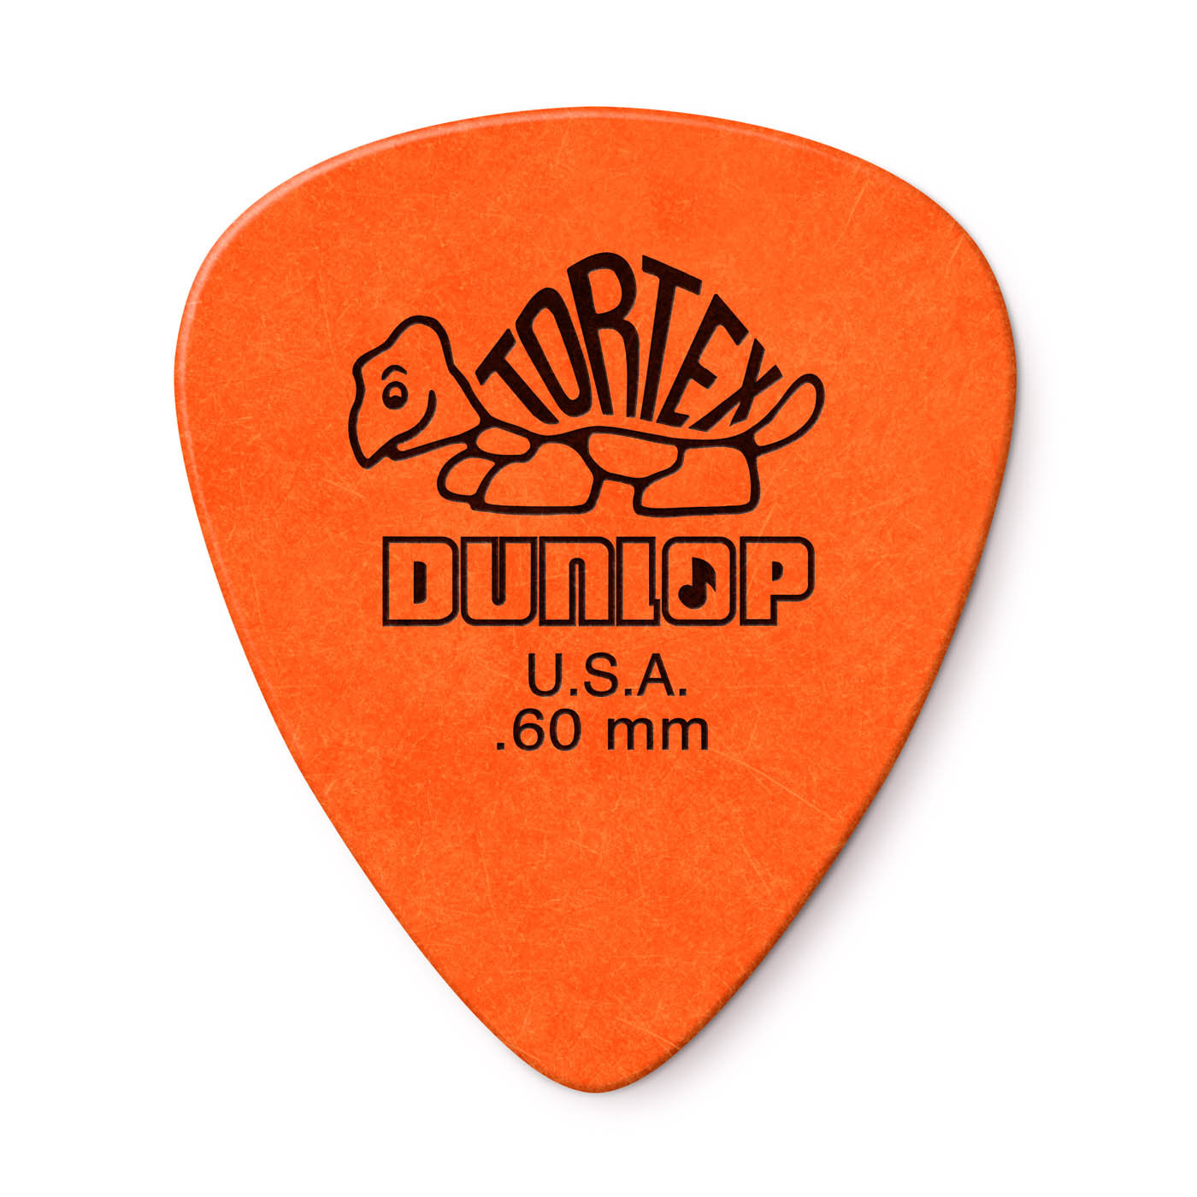

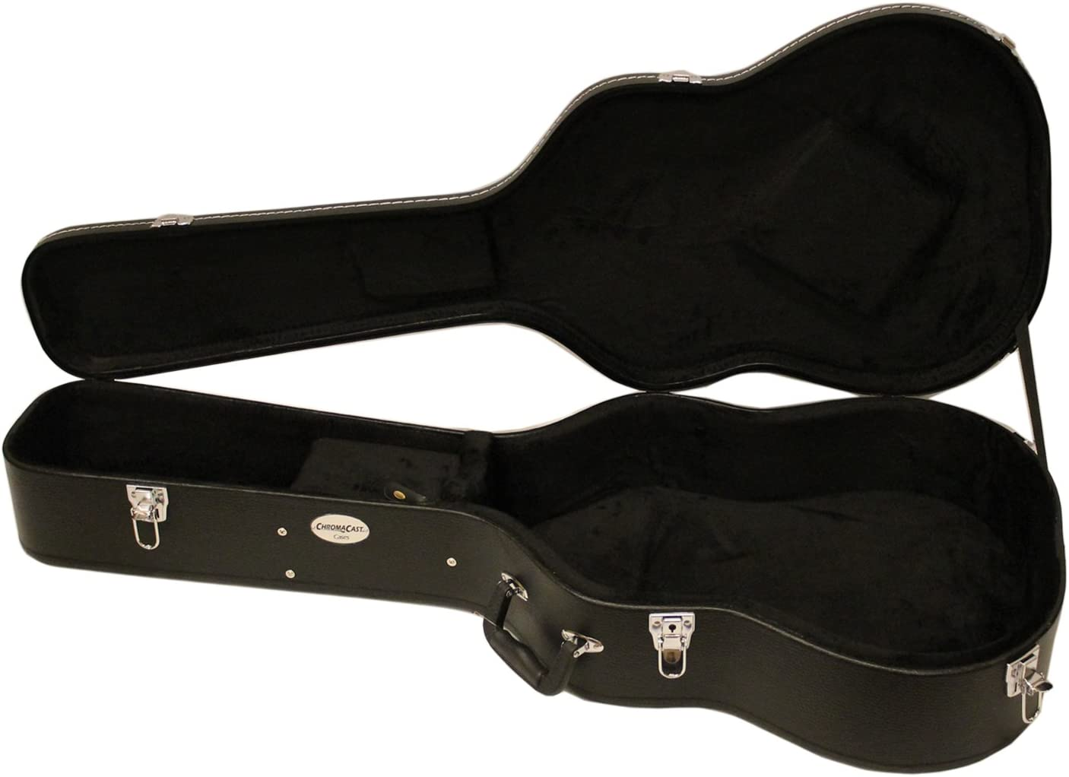
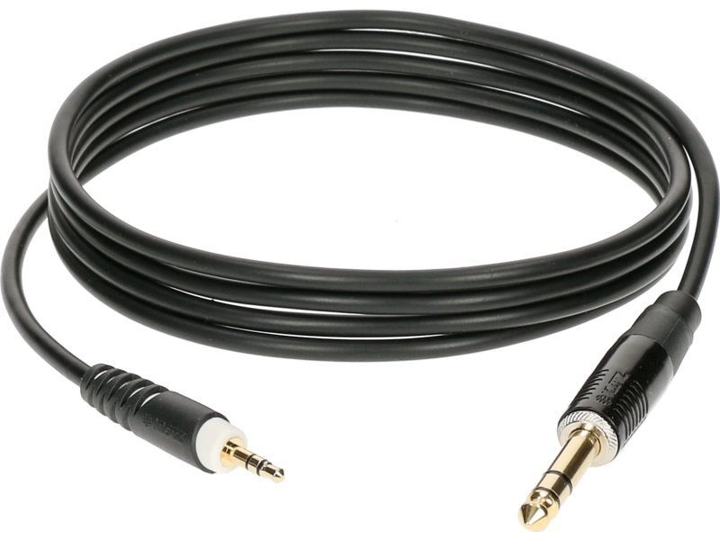
Problems
Adding Accessories

Slide 10
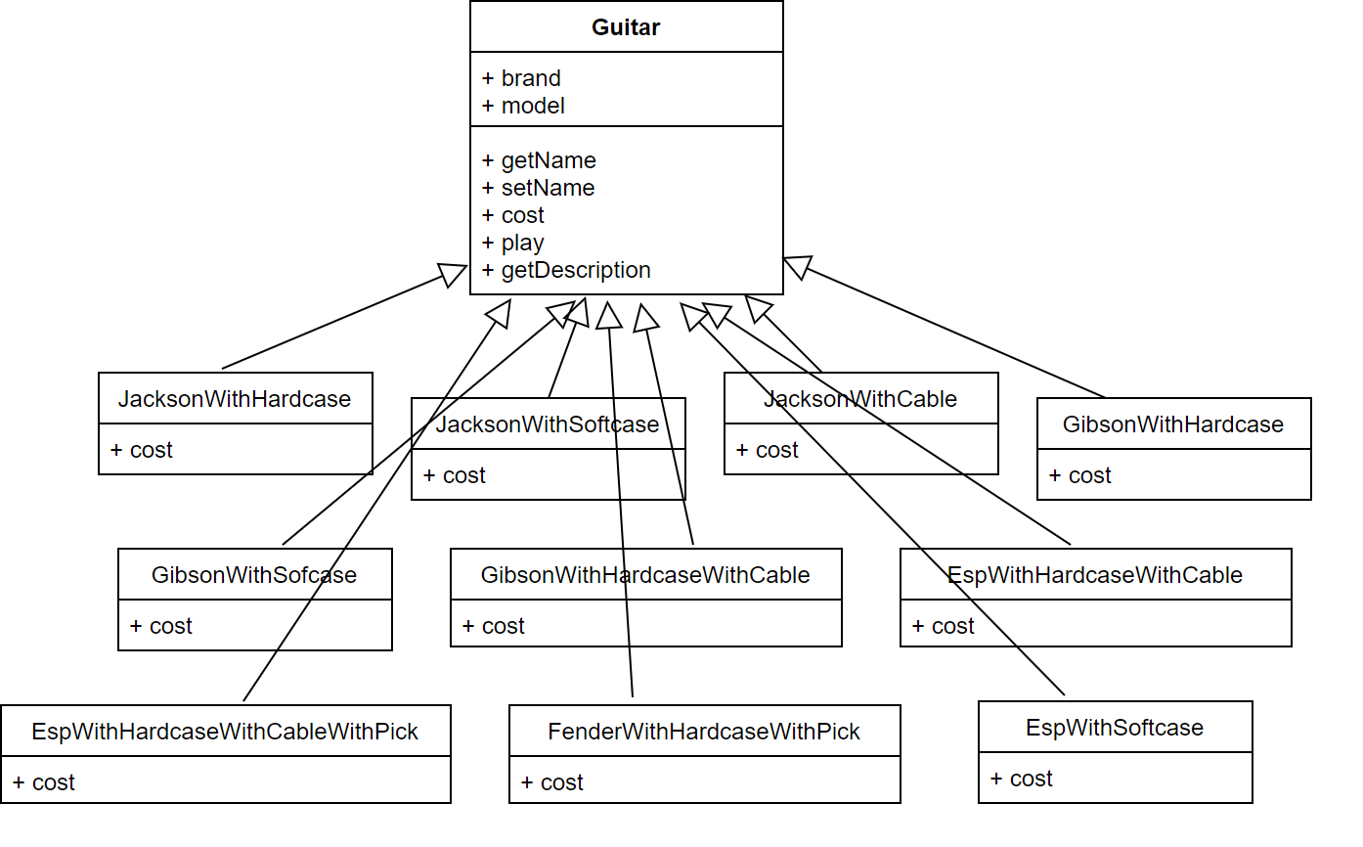

Slide 11
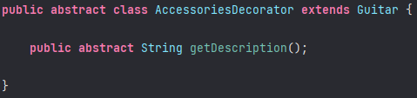
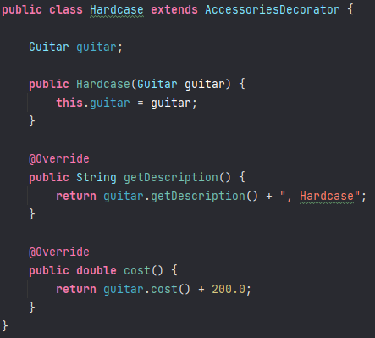
Solution
+
guitar.getDescription()
Hardcase

Slide 12
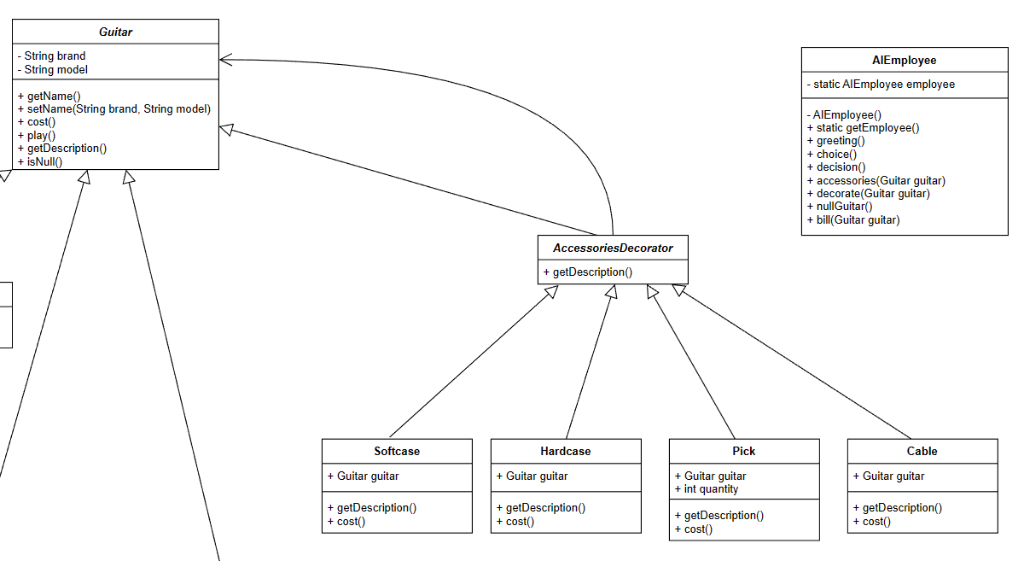



Slide 13
Conclusion
Decorator pattern was the key - Composition is used to add new behaviors at runtime - Using inheritance for type matching allows our decorator classes to have the same type as our guitar

Slide 14
Problems
Possibly Multiple AIEmployees

Slide 15
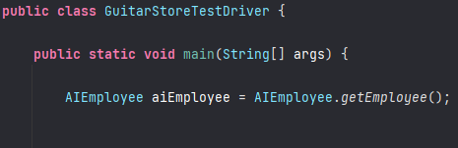
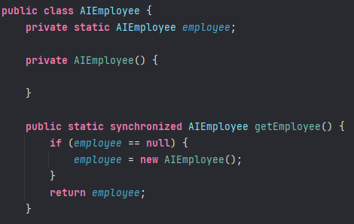
Solution

Slide 16
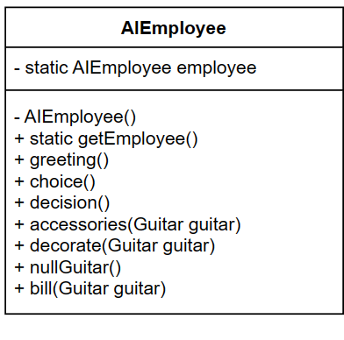

Slide 17
Conclusion
Singleton pattern was the key - We can be sure that we will have at most one instance of the AIEmployee class - We don't have any performance issues with synchronizing the method.

Slide 18

Problems
Unavailable Guitars

Slide 19
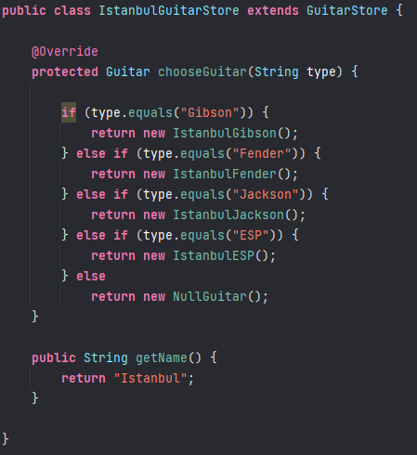
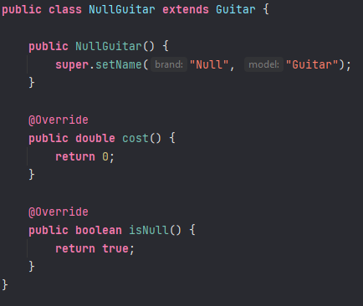
Solution

Slide 20
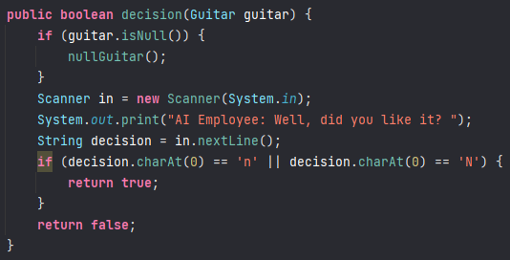
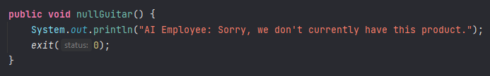

Slide 21
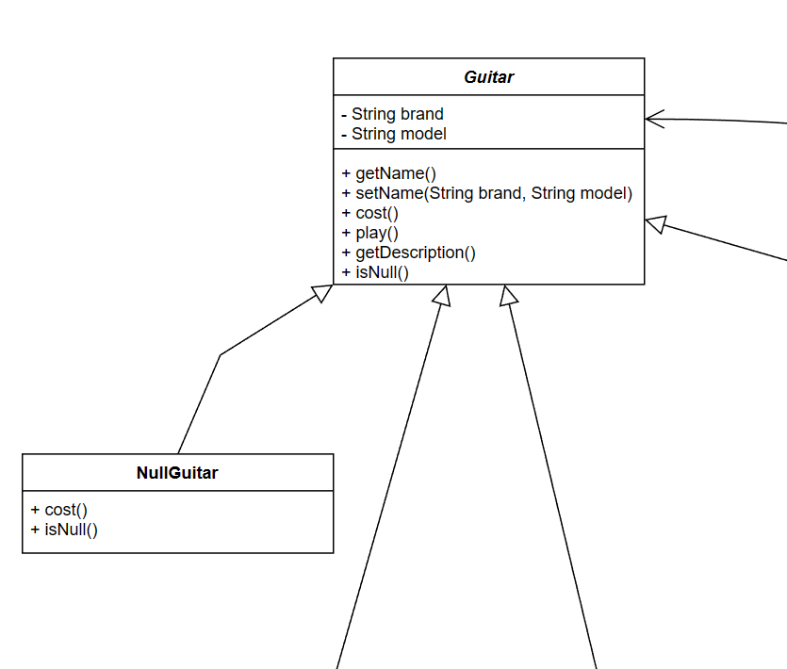

Slide 22
Conclusion
Null Object pattern was the key - If we don't have the guitar brand requested from the user in our store, it makes our job easier to create a null guitar and handle it within other methods.

Slide 23
Complete UML Diagram

Slide 24
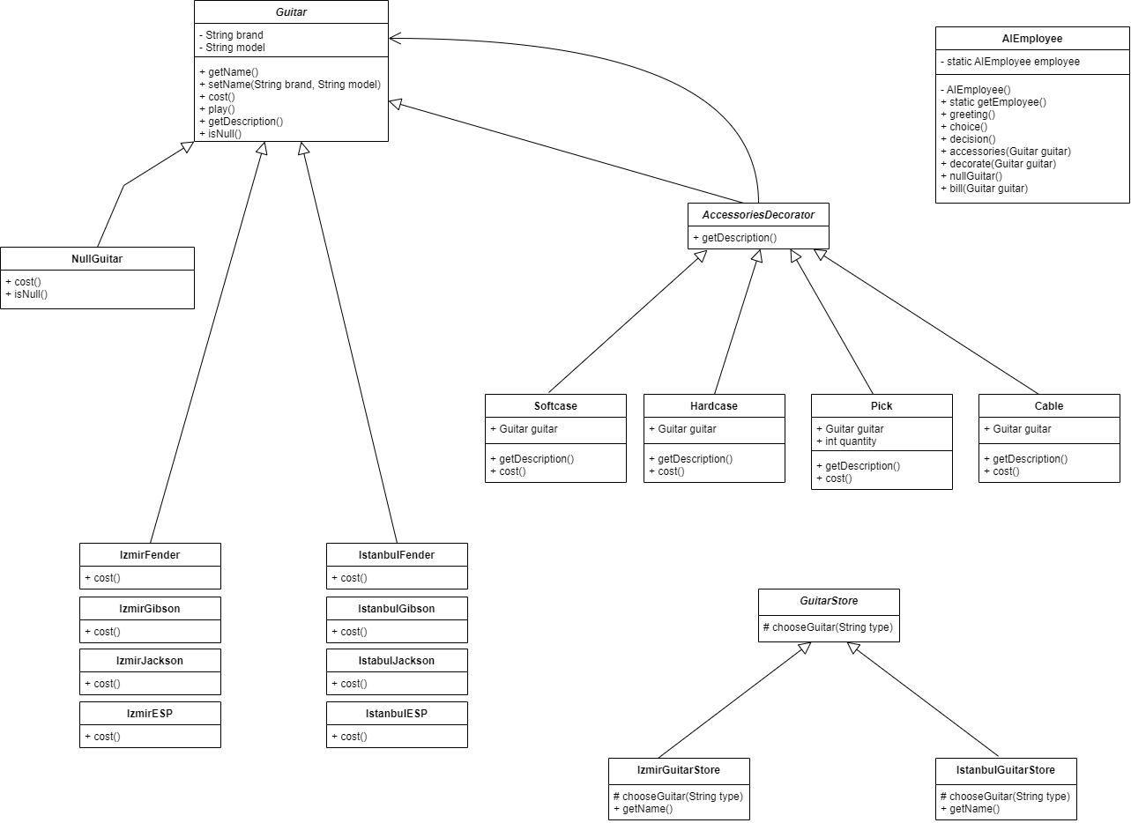

Slide 25
Thank you for listening!

